Slide 1
Genetic Algorithm
ESC 202

Slide 2
Agenda
Introduction
Problem
Approach
Code Implementations
Results

Slide 3
What is a Genetic Algorithm?
Fitness like in Nature
Propagation of genes
Mutation

Slide 4

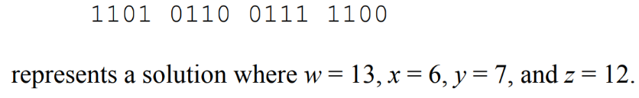
Choosing the problem to solve
Static problem
Limited number of variables
Array-like structure of bot

Slide 5
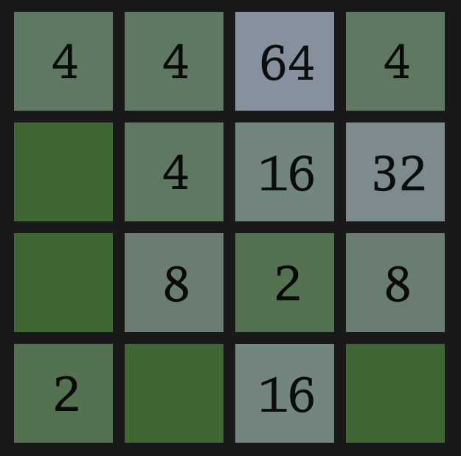
2048
Goal: Merge number blocks and try to reach 2048+
Only 4 possible moves
Relatively static
Solution can be stored in an array

Slide 6
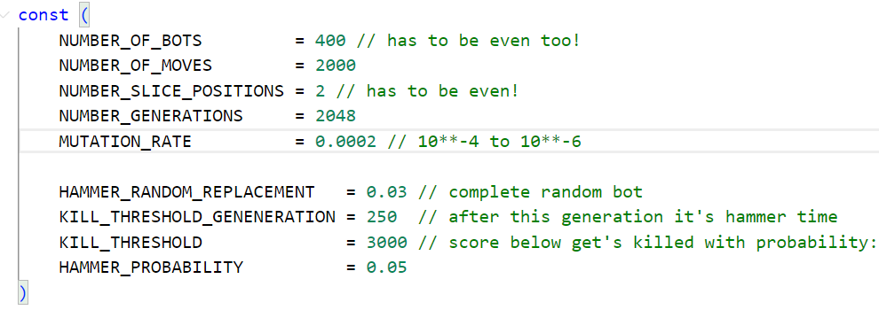
Constructor Variables

Slide 7
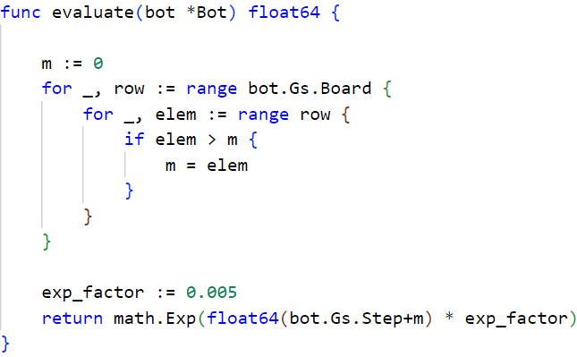
Fitness (Score)

Slide 8
Children (Next Generation of Bots)
Chosen Parents: [W, S, N, N, S, O, W, N]
[S, N, O, W, W, S, N, O]
Random Slice: [2:5]
Provisional Children: [W, S, O, W, W, S, W, N]
[S, N, N, N, S, O, N, O]
Random Mutations: [W, S, O, S, W, S, W, N]
[S, N, N, N, S, O, N, O]

Slide 9
Genetic Algorithm Results
Reaches 2048 in about 1450 Generations
Still some bots reaching only low scores
~10min for 2048 Generations

Slide 10
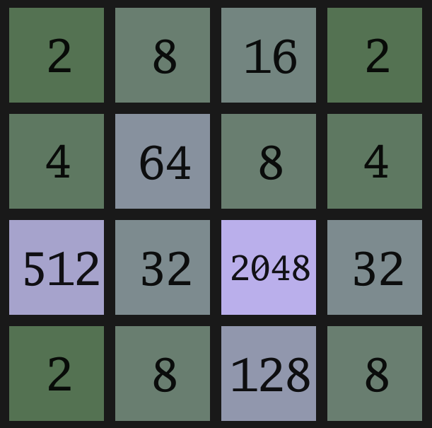
Best Bot

Slide 11
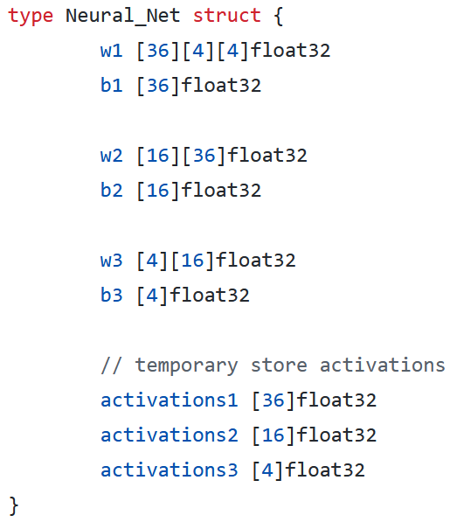
Neural Network Setup
Mutate parameters by replacing random weights, biases
Simple score function prefers stronger neural networks:
score = exp(0.01*max_steps)
Argmax of activations3 array gives the direction
Problem: Invalid input direction leads to infinite loop
Solution: Replace with next valid direction
North->East->South->West

Slide 12
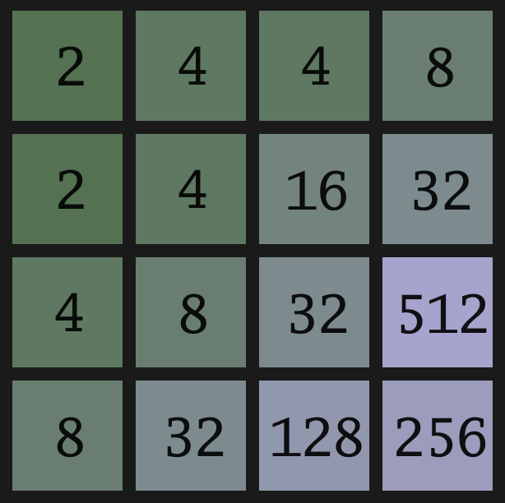
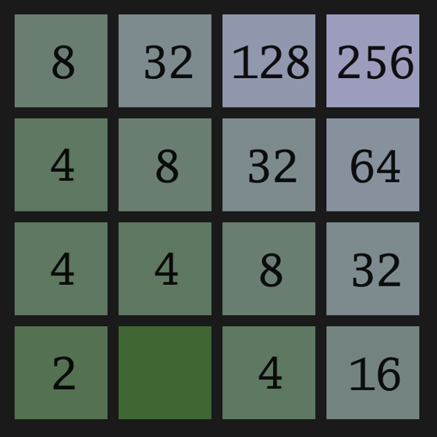
Corner Strategy

Slide 13
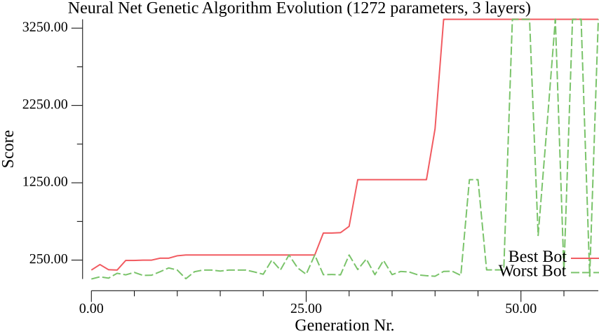
Neural Network Results
Only reached 1024 block
Genetic Algorithm not optimal for training Neural Networks
Large amount of parameters needed
More sophisticated crossover and mutation needed

Slide 14
Thank You
Project by:
Benjamin Frölich & Martin Lais

